Slide 1
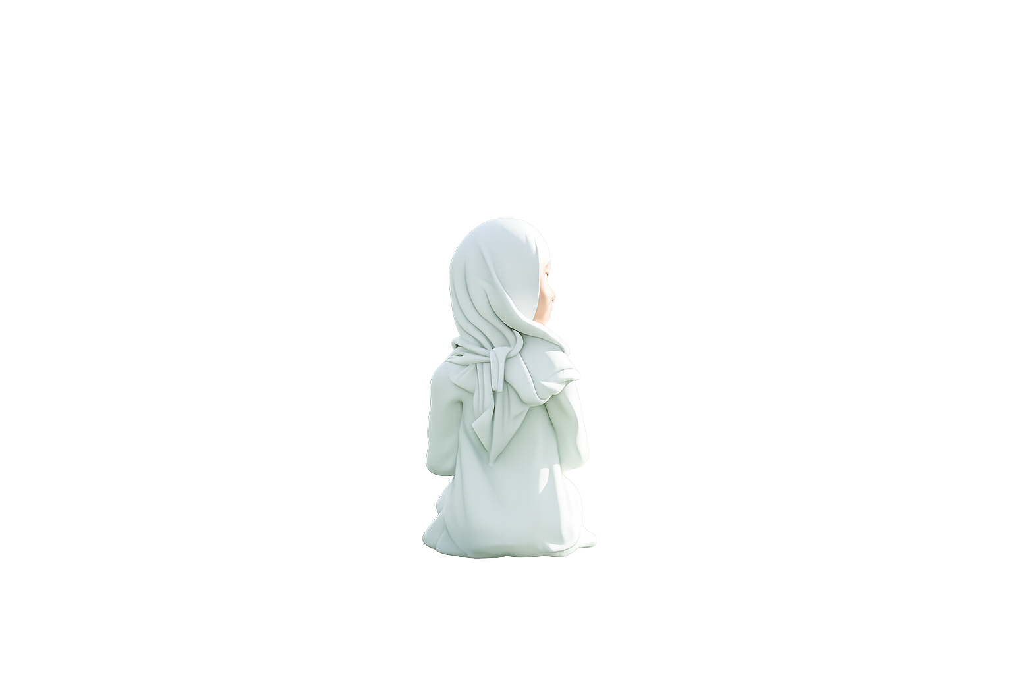
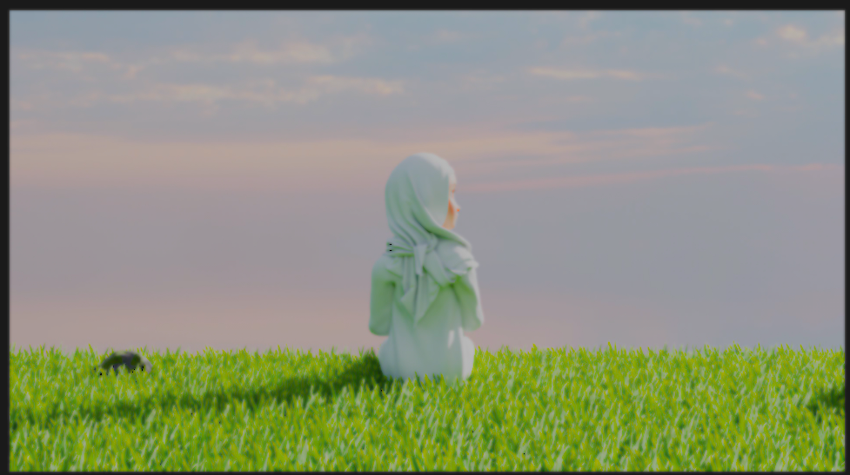


RE-LIVE
SHORT FILM
WORKSHOP II

Slide 2

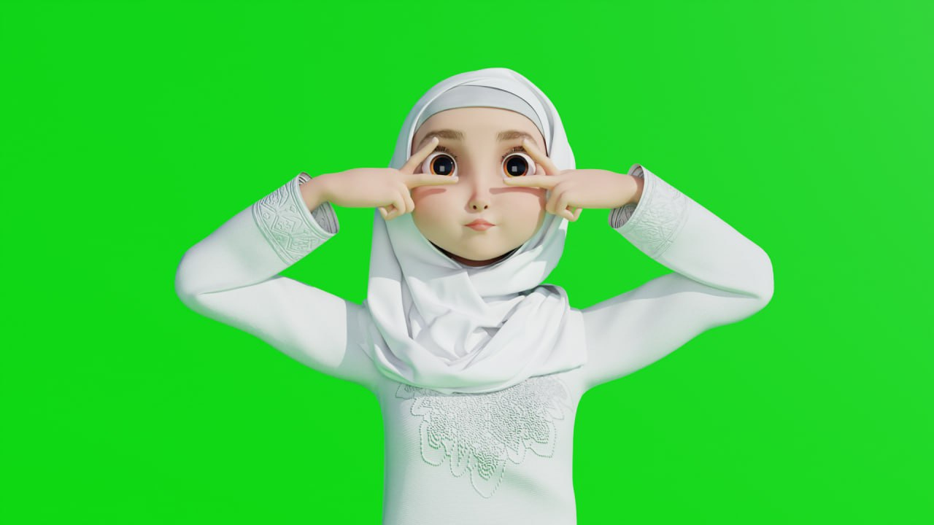
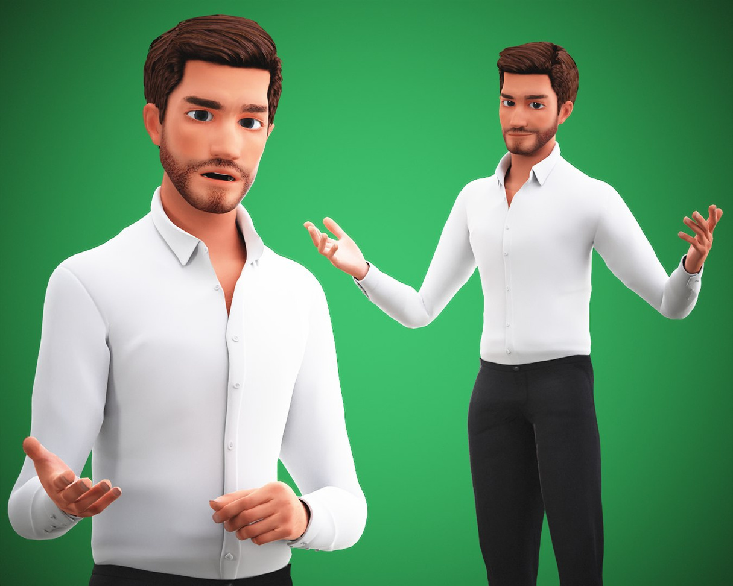
TABLE OF CONTENTS
Project Overview
Character & Asset Development
Concept & Story
Animation Process
Storyboard & Planning
Tools & Software

Slide 3
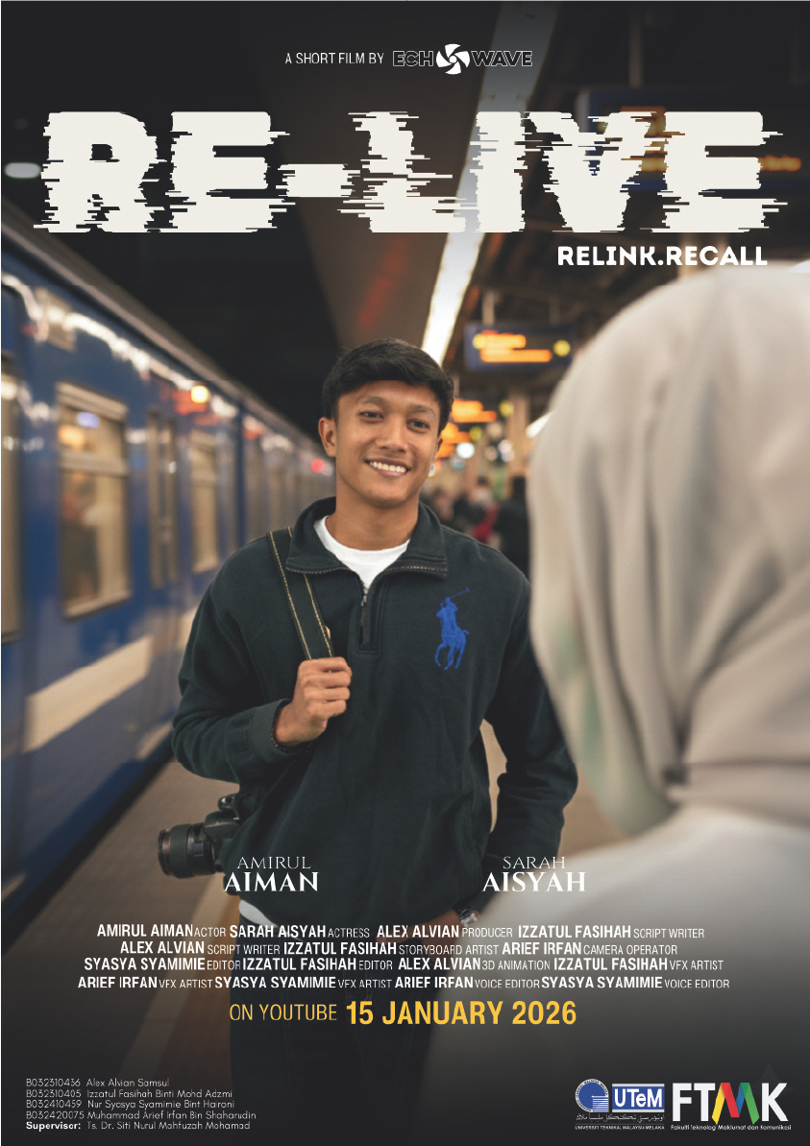

PROJECT OVERVIEW
ReLive is a short animated film created using Blender.
It explores the transition of a character from the real world into a digital 3D environment, representing escape, imagination, and self-reflection.

Slide 4
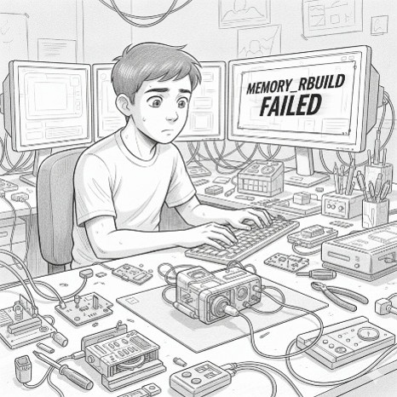
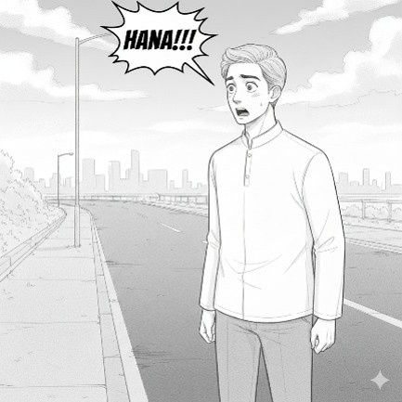

It explores the transition of a character from the real world into a digital 3D environment, representing escape, imagination, and self-reflection.
CONCEPT & STORY
Core Idea
A visual journey between reality and imagination, representing emotional escape through digital creation.

Slide 5
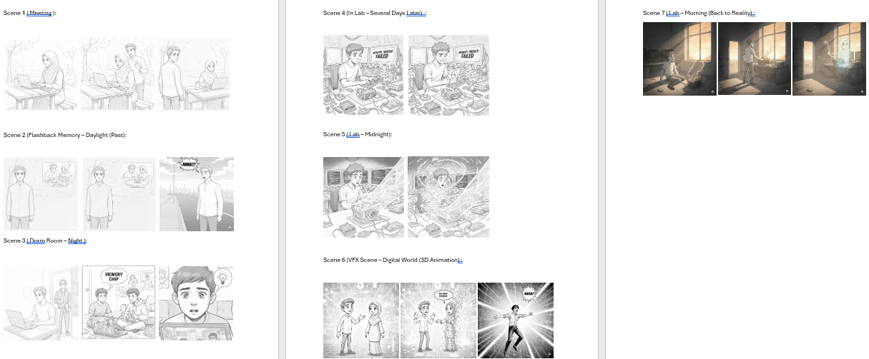
STORYBOARD & PLANNING
This stage involves planning the full sequence of shots before animation begins.
Storyboards were created to define:
Camera angles and composition
Scene progression
Key emotional moments
Timing and pacing of the animation
This step ensured a clear visual direction before production in Blender.

Slide 6
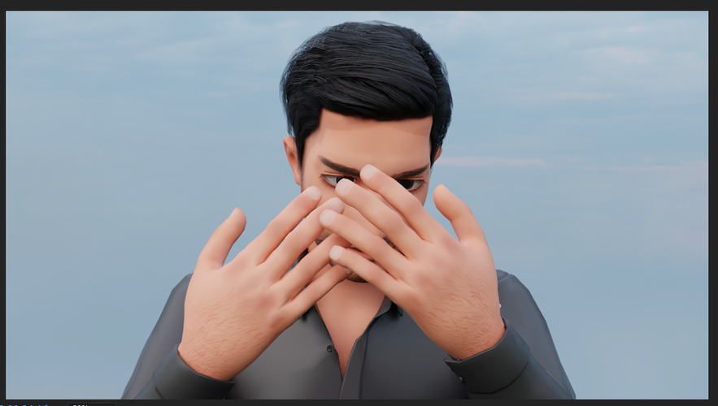
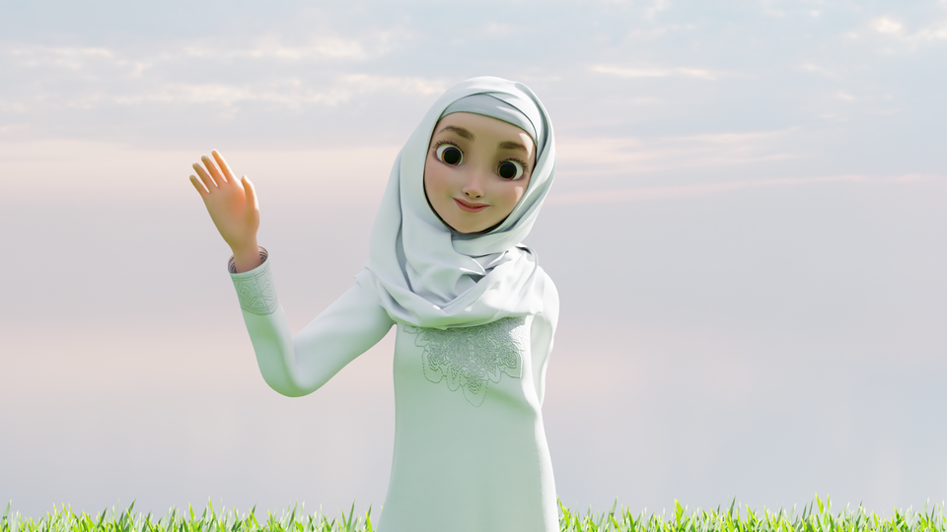
CHARACTER & ASSETS
Rafiq
Hana

Slide 7
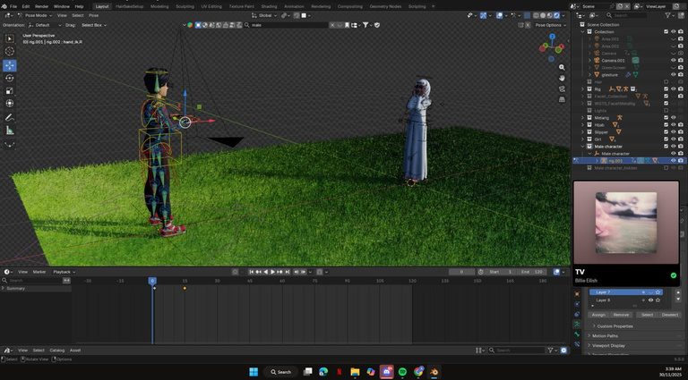
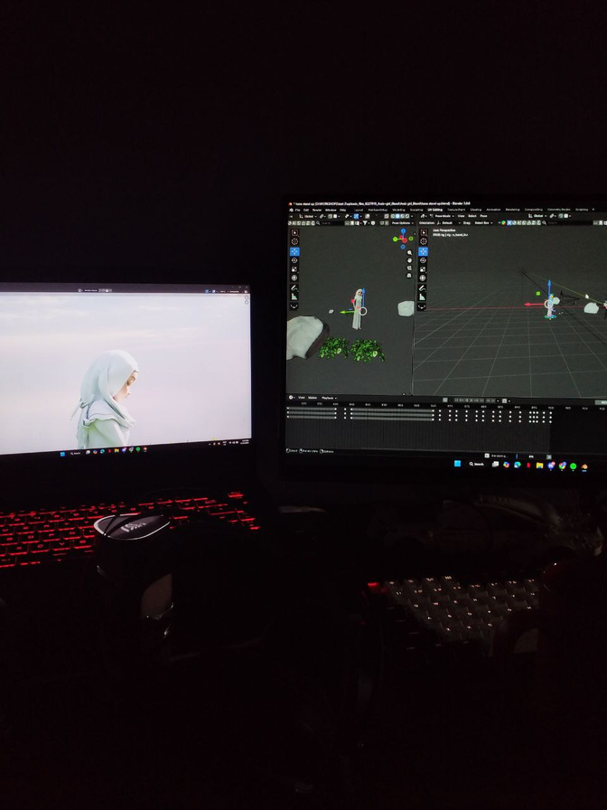
ANIMATION PROSES
The animation was created using keyframe animation techniques in Blender.
Work involved:
Character posing and movement blocking
Facial and body animation (if applicable)
Timing adjustments for smooth motion
Refining keyframes for better performance
This stage brought the story to life through motion and expression.

Slide 8
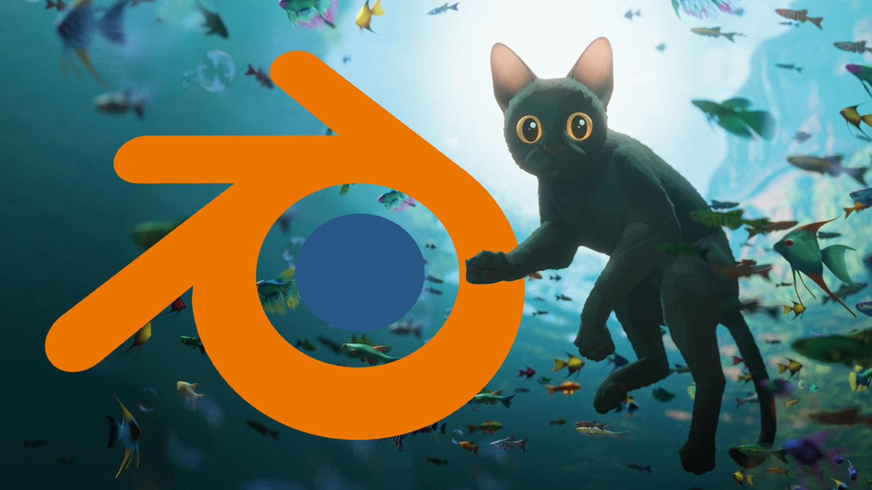
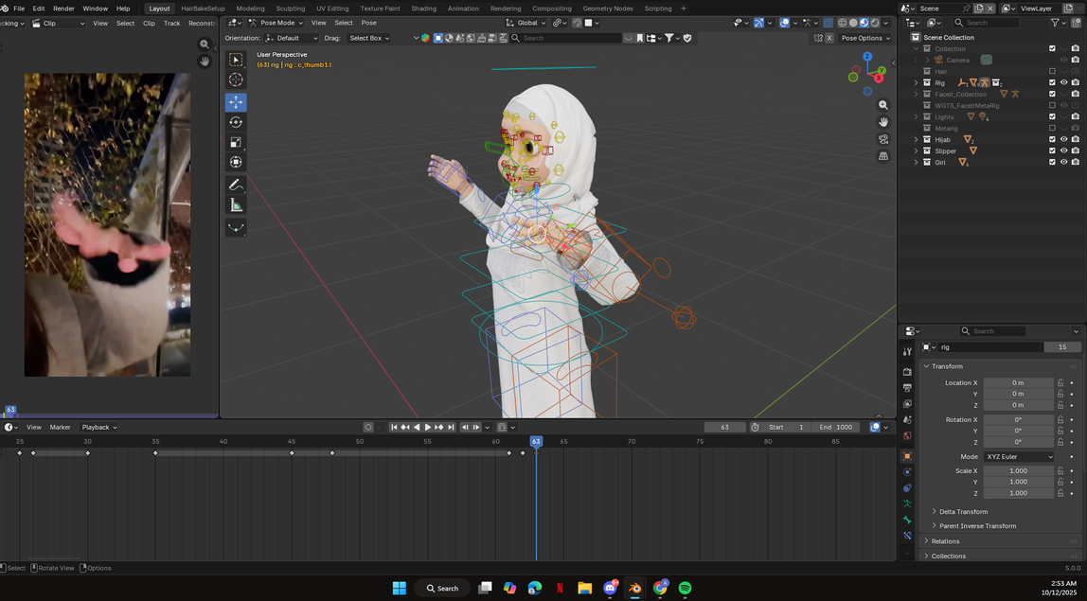
This project was created using the following tools:
Blender (Modeling, Animation, Rendering)
Adobe After Effects (Compositing & Post-production)
Adobe Premiere Pro (Editing)
Photoshop (Concept / texture support if needed)
TOOLS & SOFTWARE

Slide 9
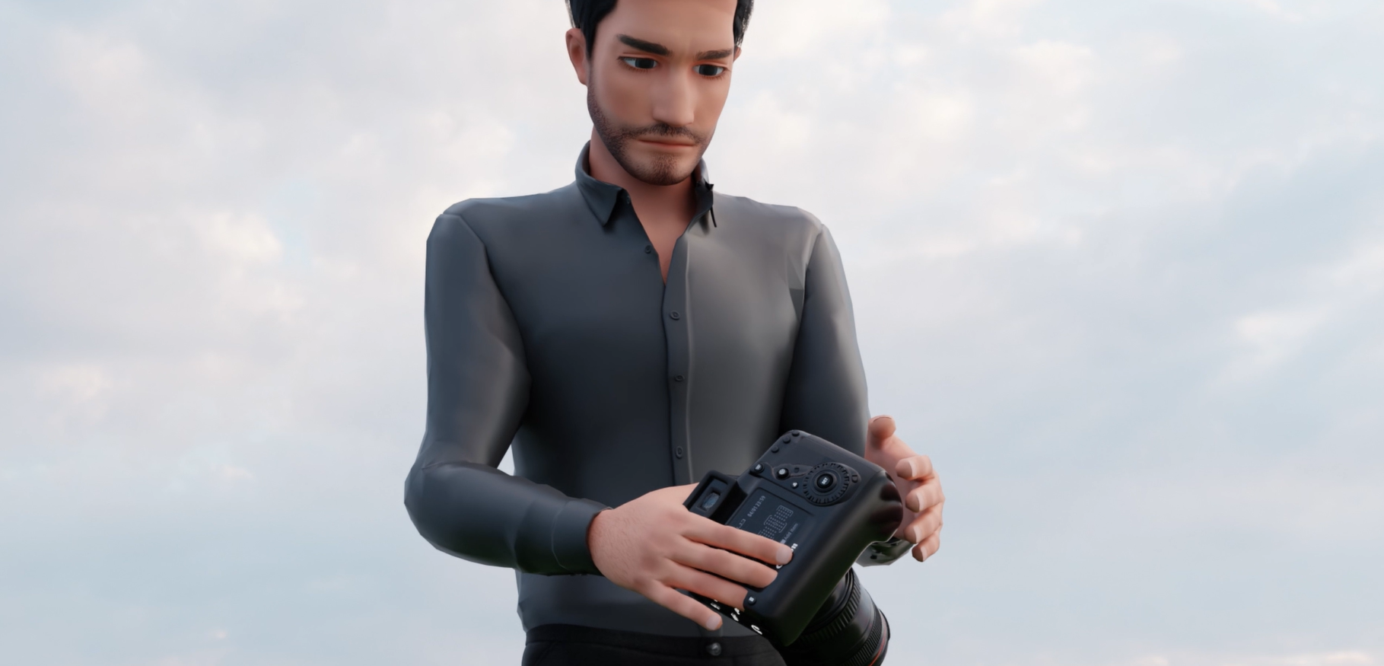
THANK YOU
+6011 6481 2238
www.linkedin.com/in/alexalvian
selviansamsul@gmail.com
https://senseinsem.github.io/Portfolio/
Sabah, Malaysia

